Slide 1
Payments GenAI Hackathon
Aug 21, 2024
Use Case: Compliance AI
Team:
DeltaByte
Priyanka Patil
Supreeya Miller
Abhilash Patlolla
Manikanta Gurram
Vikram Mehta
Hao Lu
Notes:
In this presentation, we will explore how our team used GenAI to create a thoughtful, impactful and profitable solution specifically for our Payments customers.

Slide 2
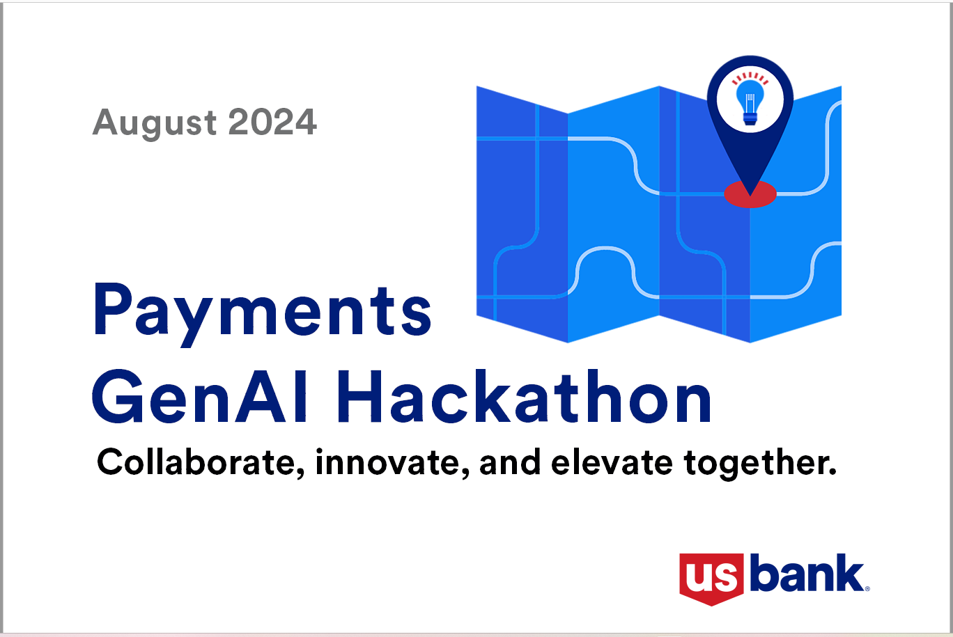
Overview
Problem statement and proposed solution
The presentation will begin with an introduction to the problem statement and the proposed solution that the hackathon aimed to solve.
GenAI software and its impact on the solution
In this section, we will explore why GenAI was chosen for this problem and the benefits it provides.
Building the next iteration of the product for Payments
The final section of the presentation will focus on how to build the next iteration of the product using GenAI.
<<Replace this placeholder image with screen shot or visual of solution>>
Notes:
We will start by discussing the problem statement and proposed solution that we wanted to tackle at the hackathon. Then, we will explore why GenAI was chosen for this problem, and the impact it had. Finally, we will discuss how our solution can be considered for further development with the Payments business line, making a lasting impact on our company and its operations. to build the next iteration of the product using GenAI.

Slide 3
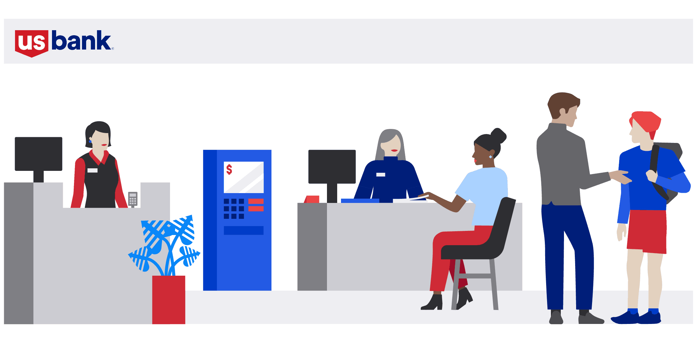
Problem statement
Challenges with CMRA
The CMRA process used by bank team members to get customer facing documents approved currently takes two weeks to complete, because of the heavily manual review procedures.
Importance of solving CMRA’s long turnaround time
The long turnaround has become a bottleneck for the CMRA process, causing significant amount of time loss and hidden cost.
<<picture or sketch displaying persona, challenge they face and/or customer challenge they face>>
Notes:
In the hackathon, our team aimed to address challenges with by solving for <<which one of these use cases?>>:
Streamline invoice and receipt processing, including approval workflow.
Automate process to extract data from payment remittance advice messages and match to invoices.
Enable sales to deliver customized and efficient sales support.
Coach TMC by simulating interactions as part of skill development program.
Build a sales assistant offering real-time conversational interaction and research.
Enhance the CMRA/CAT process with speed, accuracy and efficiency.
Automate account maintenance requests received from customers via e-mail.

Slide 4

Proposed solution
Our solution uses GenAI for CMRA, that will improve employee experience, gain in productivity, improve review accuracy and eliminate looping, reduce time-to-market for products, resulting in more satisfied customers.
Benefits
Revenue
We intend to evolve the solution into a platform that will attract internal customers of various departments, then external customers such as regional smaller banks and financial institutions. This will produce tremendous demand-side competitive advantage, racking up sizable revenues.
Saved hours
Expected productivity gain: 10,080x. 2 weeks vs 2 minutes
Product quality
The proposed solution will result in a significant improvement in our current CMRA quality for Payments in terms of review accuracy, eliminating looping, and improved employee experience. This in turn reduces time-to-market for products, resulting in more satisfied and loyal customers.
Further details
Use Azure AI tools to automate the review and generation of marketing documents.
Notes:
We propose a solution that utilizes GenAI to do <<X>> more <<accurately and efficiently>>. We will demo the details of the proposed solution and how it compares to the current solutions available.

Slide 5
Demo of solution
Architectural Diagram

Slide 6
Demo of solution
RAG approach and AI Assistant approach

Slide 7
Demo of solution
Front End Solution and Future States

Slide 8
Acknowledgement

Slide 9
Q&A

